Slide 1


Build a Personalized Online Course Recommender System with Machine Learning
Hasan Soufan
07-04-2026

Slide 2
Outline
Introduction and Background
Exploratory Data Analysis
Content-based Recommender System using Unsupervised Learning
Collaborative-filtering based Recommender System using Supervised learning
Conclusion
Appendix

Slide 3
Introduction
Learner across the world increasingly seek to acquire skills in leading technologies such as Machine Learning, Ai, Data Science, Cloud, App Development, etc, However with the growing number of available courses, it becomes difficult for the learners to identify relevant content efficiently. To improve the learning experience a recommender system can users discover aligned with their interests and effectively guide their learning path.
Currently, learners struggle to discover relevant courses due to the large volume of available content. This led to inefficient course selection and reduced engagement, ultimately affecting learning outcomes and platform effectiveness.

Slide 4
Exploratory Data Analysis

Slide 5
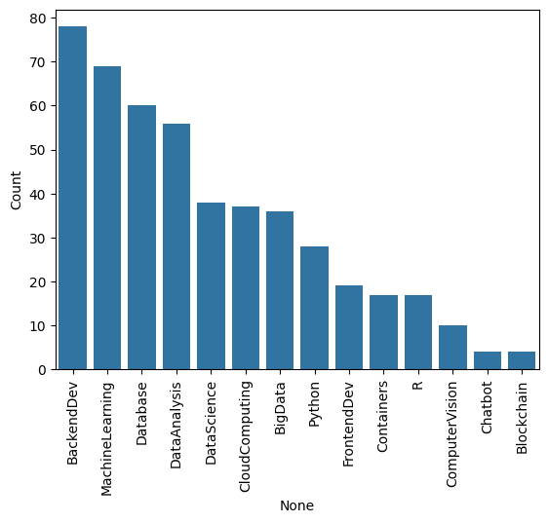
Course counts per genre
This chart shows the distribution of courses enrollments across different categories.
The x axis represent the courses genre, and the y axis show the number of enrollments.
We can see that BackendDev has the highest enrollments and the Blcokchain has the lowest.
Following the trend we can see the learners are more interstead in Data, ML and Backend skills.

Slide 6
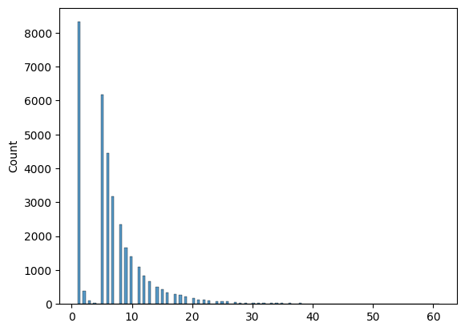
Course enrollment distribution
This chart shows the distribution of courses enrollments across users.
The x axis represent the courses number, and the y axis show the number of users (count).
most users are concentrated below 10 courses.
The distribution is skewed to the right indicating that while most users take few courses, a small number of users enroll in many courses

Slide 7
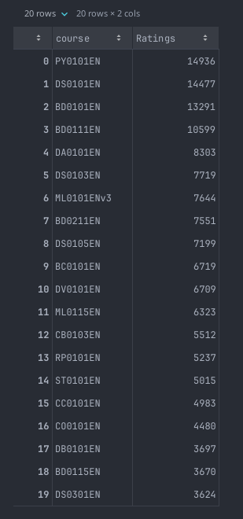
20 most popular courses
The top 20 courses show a clear concentration of enrollments in a few highly popular courses, with the top courses exceeding 13000 enrollments.
After the top 5, there is noticeable drop, with enrollments decreasing to around 8000 and below.
This indicate that a small number of courses dominate users interest.

Slide 8
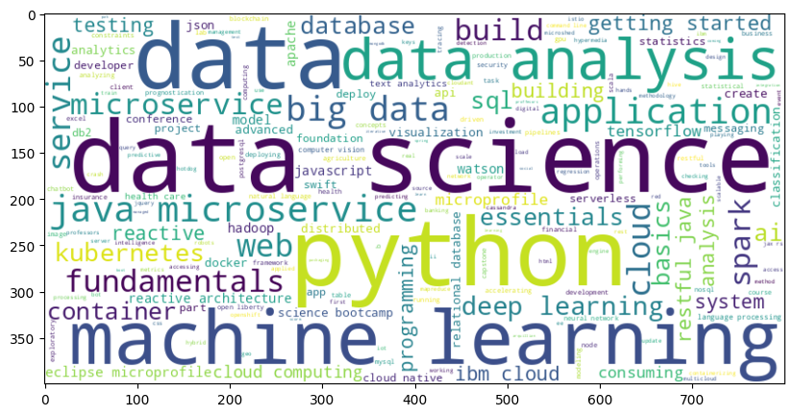
Word cloud of course titles
This word cloud represent the most frequent keywords across the courses titles and descriptions, larger words indicate higher frequency and importance.
We can observe that words like data science, data, python and machine learning dominate, suggesting a strong focus on data-driven and AI related topics.

Slide 9
Content-based Recommender System using Unsupervised Learning
Cluster2
Cluster1

Slide 10

Flowchart of content-based recommender system using user profile and course genres
Starting by getting the user data then creating vectors for each profile after that selecting the unseen candidates, then we calculate the similarity scores, applying the recommendation threshold, finally getting the recommended scores.

Slide 11
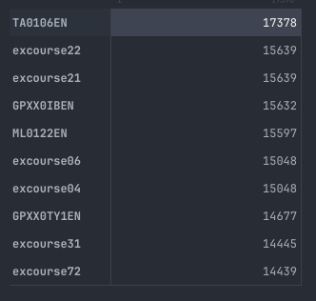
Evaluation results of user profile-based recommender system
Recommendation Score Threshold: 10.0
On average, 60 courses have been recommended per user.
- the top-10 commonly recommended courses across all users

Slide 12
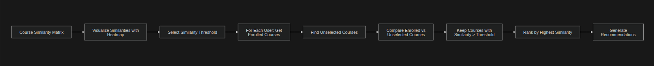
Flowchart of content-based recommender system using course similarity
Starting by getting the course similarity Matrix then visualizing heatmap, select threshold, after that for each user selecting the unseen candidates, then we calculate the similarity scores, applying the recommendation threshold, finally getting the recommended scores.

Slide 13
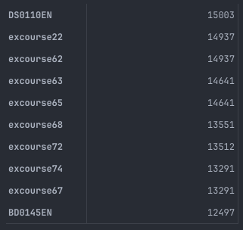
Evaluation results of course similarity based recommender system
Recommendation Score Threshold: 0.6
On average, 9.7 courses have been recommended per user.
- the top-10 commonly recommended courses across all users

Slide 14
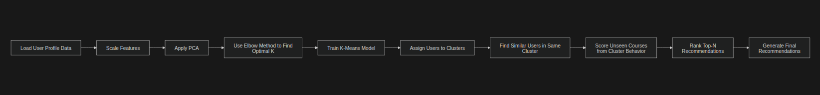
Flowchart of clustering-based recommender system
The flow starts by preprocessing user data through scaling and dimensionality reduction (PCA), followed by selecting the optimal number of clusters using the elbow method and training a K-Means model. Users are then grouped into clusters, where similar users are identified based on cluster membership. Finally, recommendations are generated by ranking unseen courses according to their popularity within each user’s cluster.

Slide 15
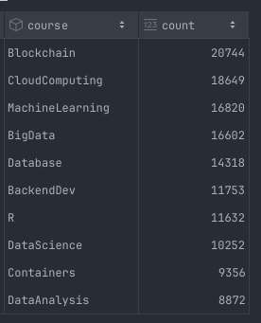
Evaluation results of clustering-based recommender system
PCA variation: 0.95, KMeans n_init: 10, n_clusters: 9
On average, each user receives approximately 4.89 new (unseen) course recommendations out of the top 5 recommendations.
- the top-10 commonly recommended courses across all users

Slide 16
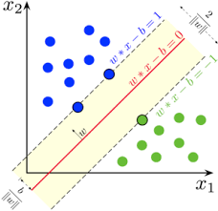
Collaborative-filtering Recommender System using Supervised Learning

Slide 17

Flowchart of KNN based recommender system
This chart start by transforms rating data into a user–item matrix, then uses cosine similarity to find similar users and predict ratings based on their preferences. The model’s performance is evaluated using RMSE by comparing predicted ratings with actual values.

Slide 18

Flowchart of NMF based recommender system
This flowchart shows a matrix factorization recommender system that learns user and item latent features through training. It predicts ratings using the dot product of learned vectors and evaluates performance using RMSE.

Slide 19

Flowchart of Neural Network Embedding based recommender system
This flowchart shows an embedding-based recommender system built with PyTorch. It encodes users and items, learns their latent representations through training, and predicts ratings using embeddings and bias terms. The model is evaluated on unseen data using RMSE.

Slide 20

Flowchart of Neural Network Embedding-Regression based recommender system
This flowchart represents a neural recommender system that combines user and item embeddings with additional regression layers to model complex interactions. The concatenated embeddings are passed through a neural network to predict ratings. The model is evaluated using RMSE on the test set.

Slide 21

Flowchart of Neural Network Embedding-Classification based recommender system
This flowchart represents a neural recommender system that uses user and item embeddings combined with classification layers to predict rating categories. The model learns to classify interactions instead of regressing exact values. Performance is evaluated based on prediction accuracy or related classification metrics.

Slide 22
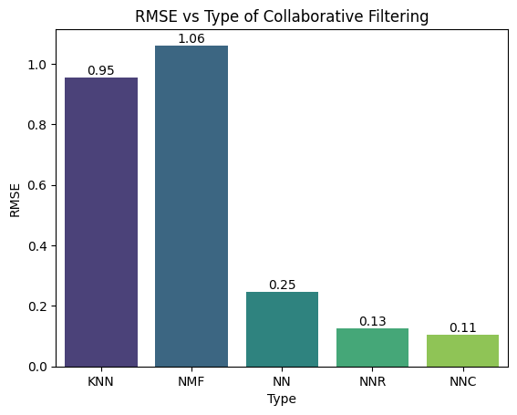
Compare the performance of collaborative-filtering models
This chart compares the RMSE performance of different collaborative filtering approaches. Traditional methods like KNN and NMF show higher error, while neural models significantly improve accuracy. The best performance is achieved by neural architectures, especially the classification-based model (NNC), indicating their superior ability to capture complex user–item interactions.

Slide 23
Conclusions
Users struggle to discover relevant courses due to content overload.
Content based, collaborative filtering, and deep learning models are evaluated approaches.
User preferences are highly nonlinear and context dependent.
Traditional Models like KNN provide baseline performance, but neural models significantly improve prediction accuracy.
Embedding-based with Classification neural architecture achieved the best results.
Cold start problem is a limitation for new Users/Items.
For future work a hybrid recommender system can give better results.

Slide 24
Appendix
Github Repository for the Code: Link

